Slide 1

Covid-19 Diagnosis using Azure Machine Learning
Dhanshri More
Principal Cloud Solution Architect- Data and AI

Slide 2

Improve clinical and operational outcomes
Situation
Exponential increase in Covid-19 Patients
Overload on clinicians and radiologists
Limited clinical facilities- ICU, Mechanical Ventilator
Solution
Quickly triage patients who have COVID-19 infection vs pneumonia .
Notes:
Predictive Care
Due to the highly infectious nature of the novel coronavirus (COVID-19) disease, excessive number of patients waits in the line for chest X-ray examination, which overloads the clinicians and radiologists as well as negatively affects the patient's treatment, prognosis and control of the pandemic.
Clinical facilities such as the intensive care units and the mechanical ventilators are very limited, in the face of this highly contagious disease, it becomes quite important to classify the patients who have COVID-19 infection vs pneumonia.
COVID-19 infection and pneumonia have very similar symptoms, so it become crucial to detect covid-19 patients, isolate them and provide the required care.

Slide 3
Problem statement
To build a Machine Learning model to detect Covid-19 patients from chest X-ray images, available in public open dataset of chest X-ray of patients who are positive or suspected of COVID-19 or other viral and bacterial pneumonias.
The goal is to build Deep Learning model based on Convolution Neural Network to detect Covid-19 patients from chest X-ray images.
This guided implementation will provide baseline to any Machine Learning/ Image Processing project to be implemented on Azure Machine Learning platform.

Slide 4


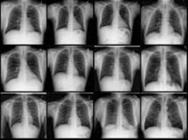



Architecture to Identify COVID-19 from X-Ray Images Convolutional Neural Network model to detect COVID-19 patients using Chest X-ray images
Open-Source Data
Data Layer
Classify & Encode
Analysis & Insight
Azure ML
Clinical Specialist / Radiologist
Power BI
Data Factory
Azure Data Lake Storage Gen2
COVID-19 Chest
X-Ray Images
Azure ML life cycle
Train
Validate
Deploy
Monitor

Slide 5
Architecture Decision
Azure Data Factory: Load data to Azure Storage
Fully managed, serverless data integration service.
Visually integrate data sources with more than 90+ built-in, maintenance-free connectors at no added cost.
Azure Storage: Scalable, secure data lake for high-performance analytics
Azure Machine Learning Services: accelerate end-to-end CNN lifecycle
Empower data scientists and developers with a wide range of productive experiences to build, train, and deploy machine learning models and foster team collaboration.
Accelerate time to market with industry-leading MLOps—machine learning operations, or DevOps for machine learning.
Innovate on a secure, trusted platform, designed for responsible machine learning.
Power BI
Self service analytics at enterprise scale
Create a data-driven culture with business intelligence for all
Keep your data secure with industry-leading data security capabilities including sensitivity labeling, end-to-end encryption, and real-time access monitoring.
Notes:
ADLS:
Is fully integrated with the Azure Blob Storage platform; Every Blob Storage capability (Azure Active Directory Integration, At Rest Encryption, High-availability and disaster recovery, Automated Lifecycle Policy Management, Storage Account Firewalls, etc.) can be used by Azure Data Lake Storage
Is optimized for leading cloud analytic engines
Is tightly integrated with all elements of the Azure Big Data Analytics stack to deliver fast insights
Allows analytics data to coexist with object data in the same store with no programming changes or data copying
Performs faster than other data stores thus making your analytics workloads run faster and lowering your TCO

Slide 6

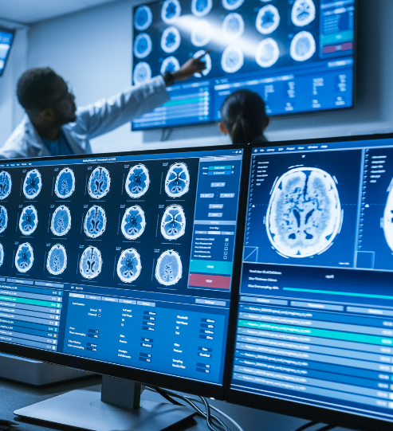
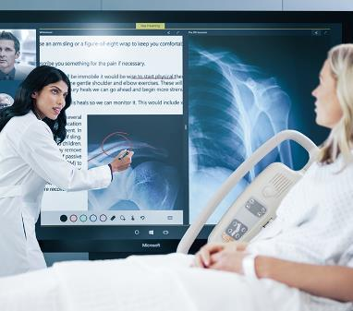
Healthcare Personas
Covid-19 detection from X-ray Image with Azure ML
Faster Triage, Better insights. Better care.
Assist Radiologist
Enable nurse for faster triage
Empower data science team
Generate ML powered Covid-19 detection to help radiologist to give decision faster
Provide faster ML assisted Covid-19 detection that will help nurse triage patients based on hospital bed and ventilator availability
Share Medical Image Processing pipeline template to accelerate ML adoption.
6

Slide 7
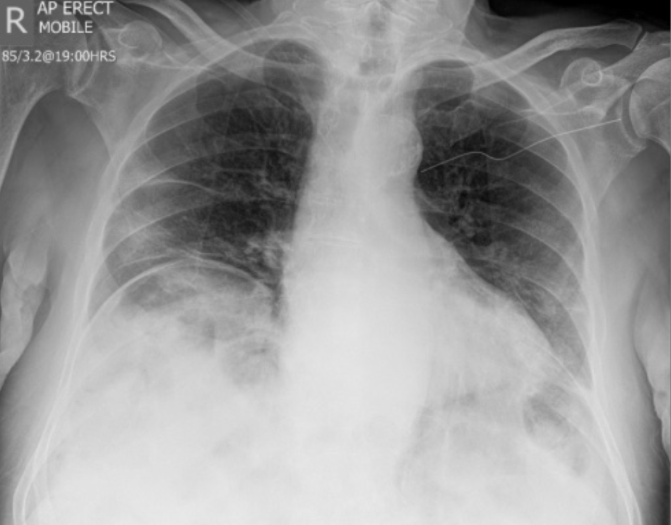
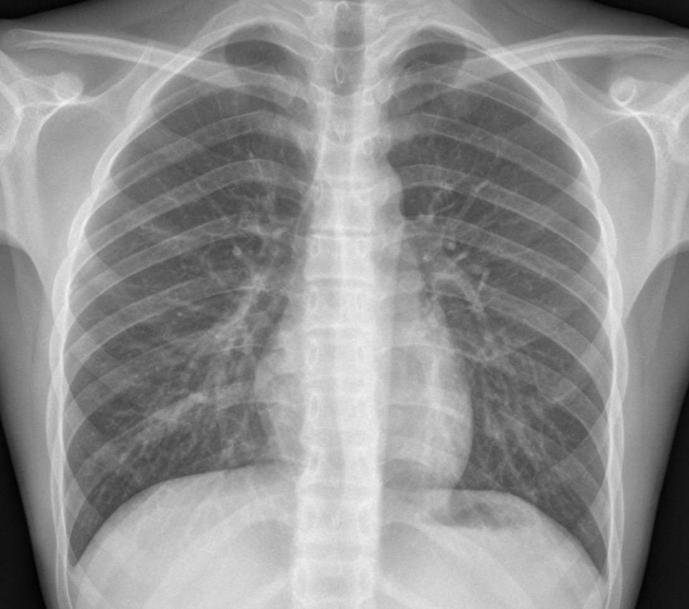
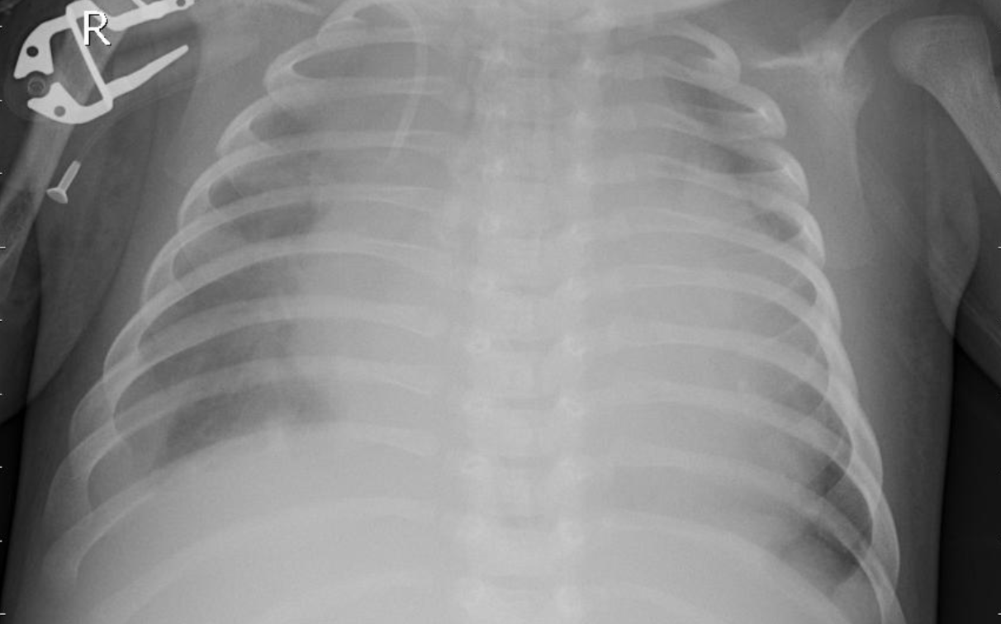
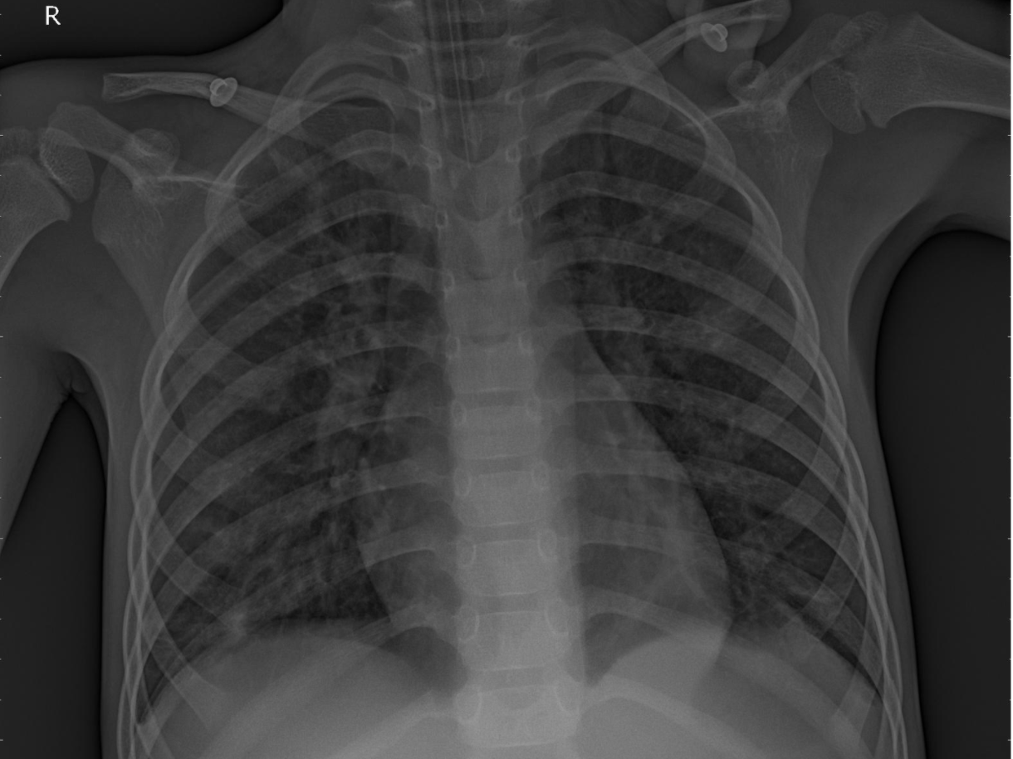
Datasets
Collected dataset from two open datasets:
COVID-19 data from IEEE
Viral and Bacterial Pneumonia data from Mendeley data and Kaggle
Combined chest X-ray data from above sources to train machine learning model to detect classes:
Covid-19
Bacterial Pneumonia
Viral Pneumonia
Normal

Slide 8
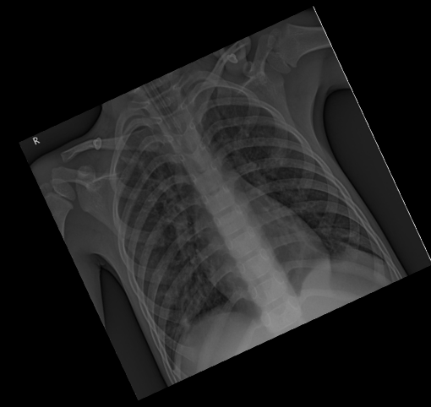
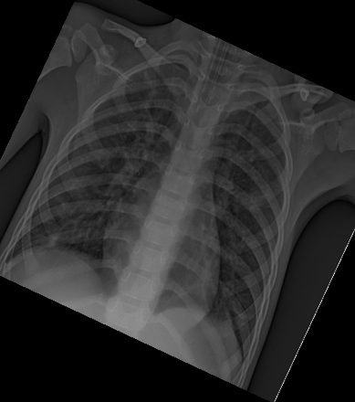
Preprocessing with Image Augmentation
Image augmentation is a technique of applying different transformations to original images which results in multiple transformed copies of the same image. Each copy, however, is different from the other in certain aspects depending on the augmentation techniques you apply like shifting, rotating, flipping, etc.
Why Image Augmentation?
expand the size of dataset
incorporate a level of variation in the dataset which allows your model to generalize better on unseen data.
The model becomes more robust when it is trained on new, slightly altered images.

Slide 9
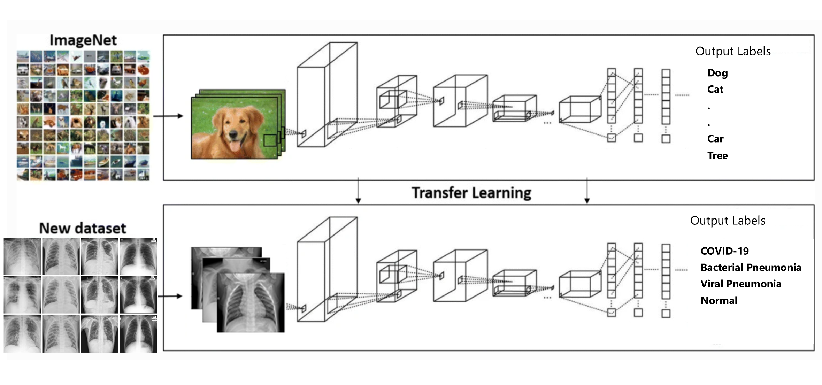
Transfer Learning

Slide 10
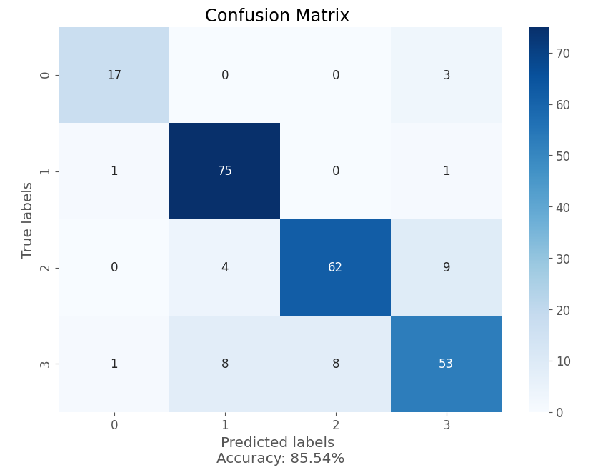
CNN Model Performance Metrics
Convolutional Neural Network with Transfer Learning
Test Accuracy = 85.54%
Compute | NC6s_v2: powered by NVIDIA Tesla P100 GPUs
Model Iteration | Hyperparameter tuning with random sampling, 10-20 model iteration
Time to train per model | 5-10 min per model

Slide 11


Slide 12
Future Direction
Explore Responsible AI
Extend with Azure Search and cognitive Services
Demographic analysis

Slide 13







Future direction
Clinical Document Ingestion
Data Layer
Classify & Encode
Analysis & Insight
Structured
Documents
Azure Blob Storage
Azure Cognitive Search
Custom Vision
Classification
search index
Trigger
Form Recognizer API
Clinical Specialist
Azure Computer Vision
Azure Cosmos DB
Unstructured Documents
Azure Function
Genetic Data
Azure ML
Covid-19 Model
Power BI
Data Factory
People
Drugs
Azure ML – Drug Efficacy Mapping Model
Azure Data Lake Storage Gen2
Disease
Train
Validate
Deploy
Monitor
Notes:
SOLUTION
Use Azure ML to map drugs against diseases on a personal level to determine likelihood of treatment efficacy
People, disease and drugs each possess ‘genetic signatures’
As these signatures (e.g., genomic sequences) can be quite complex, matching people, disease and drugs is extremely challenging
Traditional methods only work to a degree – even quantitative methods based upon the most advanced and bioinformatics grounded algorithms for searching, comparing, etc., genomics data
Deep Learning, however, has the ability to tease out relationships between people, disease and drugs where other methods result in minimal progress – and, in some cases, this has resulted in existing drugs being applied in novel situations
Here Azure Machine Learning is used to develop a custom model for drug efficacy mapping
A pre-trained version of this model can be used for inferencing purposes within the drug-discovery process
It is important to realize that methods based upon Deep Learning complement rather than remove the need for clinical trials
As recent examples demonstrate, Deep Learning has the potential to amplify and accelerate traditional methods
Ensure all data from clinical trials is actionable to support the evaluation, documentation, and use of drugs via Azure Cognitive Services & Forms Recognizer
Form Recognizer transforms unstructured clinical trials data into actionable data in minutes
Unstructured digital (e.g., unstructured PDFs, images, …) as well as printed documents cannot be actioned – note that some documents may even include handwriting
Solution digitizes all these unstructured documents – even those involving handwriting
Much more than just OCR (Optical Character) recognition, the solution classifies the type of document, and extracts field names and values to glean context
Parse for semantics and marked up for knowledge mining with Azure Cognitive Search
Fragments of text can be parsed, marked up and used to drive semantic search – thus realizing the promise of introducing knowledge mining into previously ‘opaque’ (aka. dark data) documents … documents opaque as they were previously unstructured …
Further leverage actionable data in custom analytics to derive unique insight
As excerpts of text can now be quantified in various ways, quantitative analytics can now be applied to previously unstructured documents – documents that could only have been regarded qualitatively in isolation
It is important to draw out the value of this progression from unstructured documents in isolation to highly actionable data across extremely large volumes of data
Of course, data from now-actionable unstructured documents can be combined with that from structured documents to deliver insight on even-broader scales …

Slide 14


Using AI for Predictive Care Guidance Accelerate & ensure quality diagnostics for improved health, safety & lower costs
ML Prediction
AI allows individuals to be reliably identified for COVID-19 & triaged for individualized care guidance
SOLUTION
Diagnosis & proactive intervention based upon predictive risk modeling with help of Azure ML
OUTCOMES
Easily identify those in need of intensive care and reduce Covid-19 transmission
Notes:
Predictive care includes identifying and facilitating preventative diagnosis and care plan. Use advanced medical imaging with AI to enhance safety and optimize triage by using AI based X-ray imaging to detect Covid-19 individuals, and isolate for additional screening and fast track tests based on patient history and identified high-risk conditions.
AI TRANSFORMATION
AI allows individuals with presenting symptoms to be reliably spotted within a crowd without contact or privacy implications
AI allows individuals to be reliably identified for COVID-19 & triaged for individualized care guidance
SOLUTION we provided is
To orchestrate model training, deployment & use over their entire lifecycle using AML
OUTCOMES
Proactively manage population health to avoid overwhelming public health systems
Easily identify those in need of healthcare

Slide 15

Thank you!
Notes:
Thank You

